Slide 1
Carbon Monoxide Initiatives
Mark Oliver
Director of Business Services

Slide 2
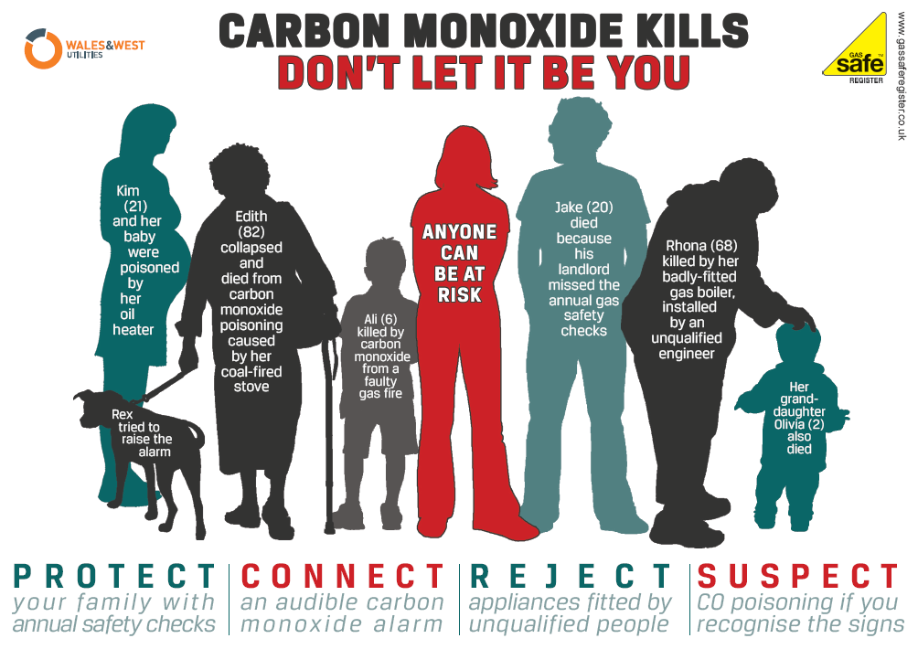
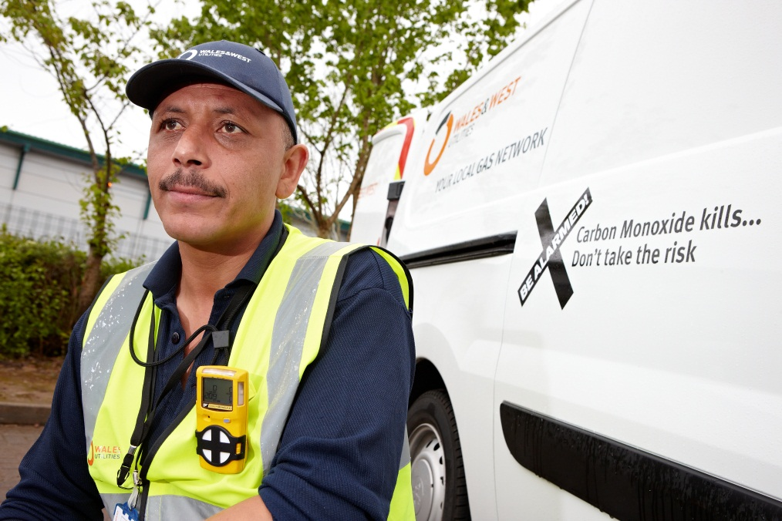
Background
In 2012, Wales & West Utilities’ first call operatives attended nearly 7,000 emergency visits relating to suspected reports of Carbon Monoxide
At WWU we take a proactive approach to raise awareness, amongst our direct labour and contract staff and more widely to the 7.5 million people within our network area.
This follows in incident where one of our First Call Operatives was overcome by carbon monoxide whilst attending a routine emergency call
Our initiatives will serve to raise awareness of the dangers of CO which was supported by our stakeholders
Details of our initiatives are in our Business Plan submission to Ofgem. Copies available from our website; www.wwutilities.co.uk

Slide 3
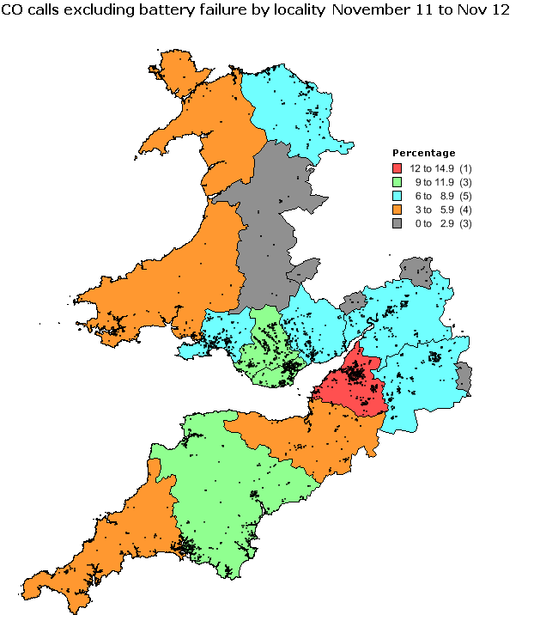
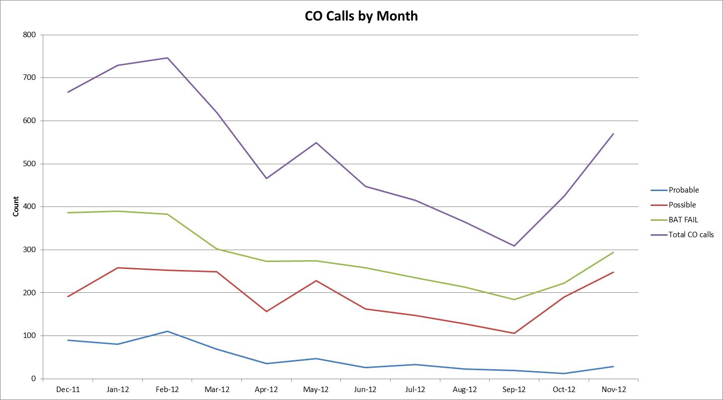
Data Analysis
At every incident, WWU’s engineers provide advice and support onsite.
Incident trends are tracked monthly by locality, stripping out battery failures.
This enables us to proactively target awareness campaigns to those areas most at risk.
This data is reviewed at our monthly Executive Safety meeting to raise awareness and agree strategy.

Slide 4
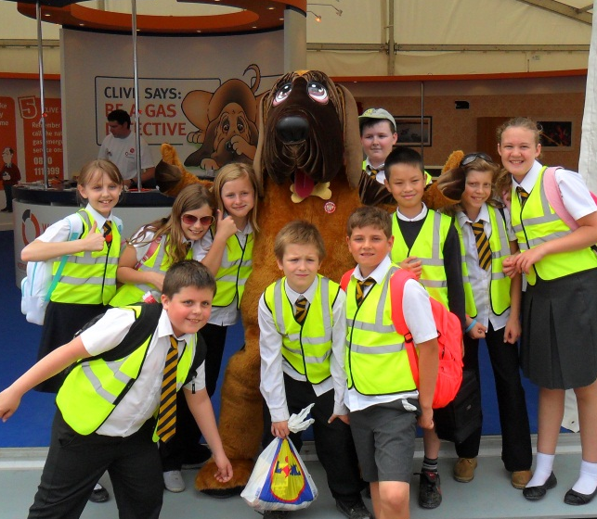
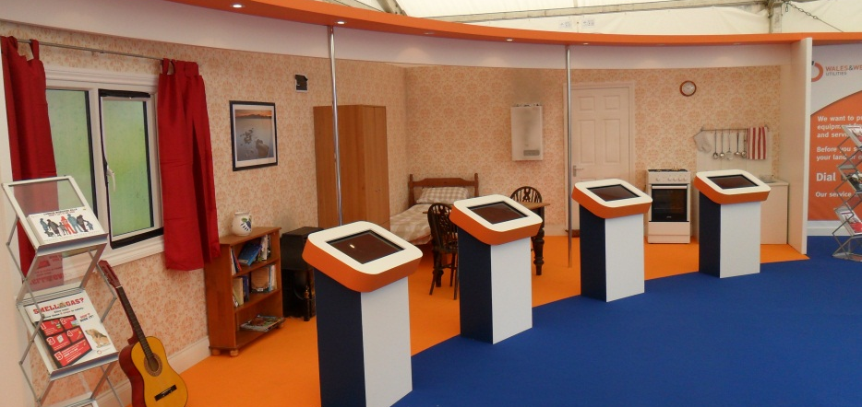
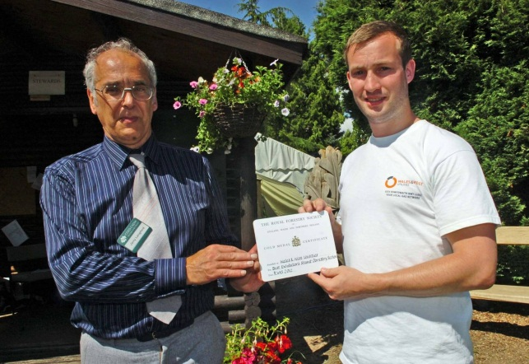
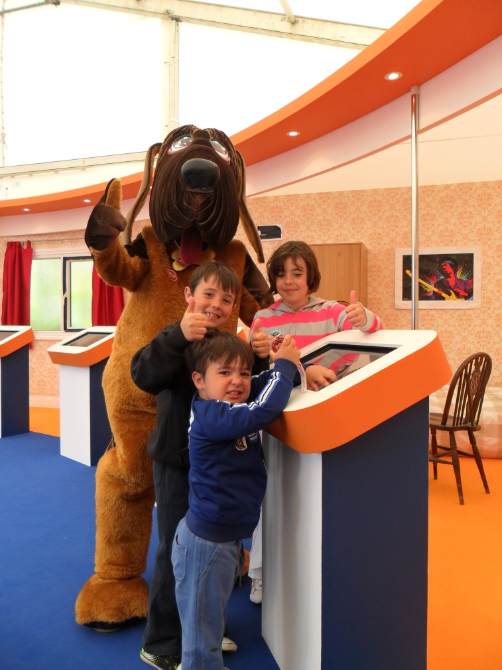
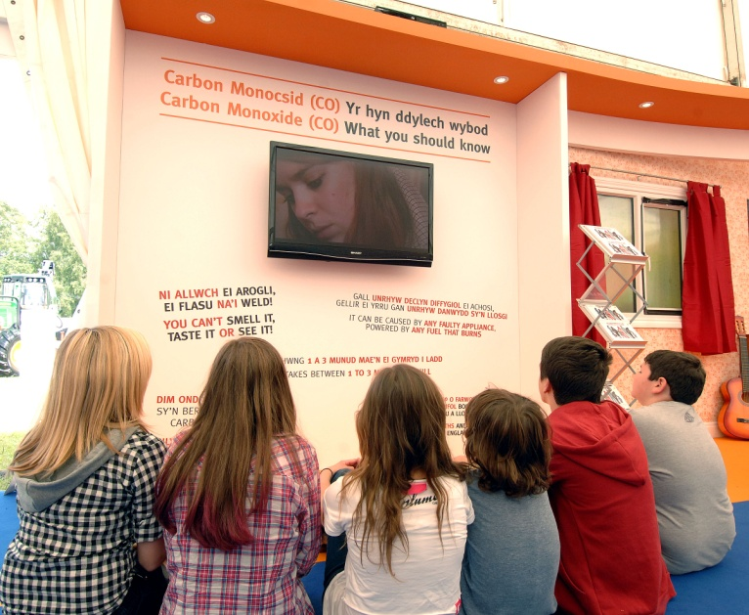
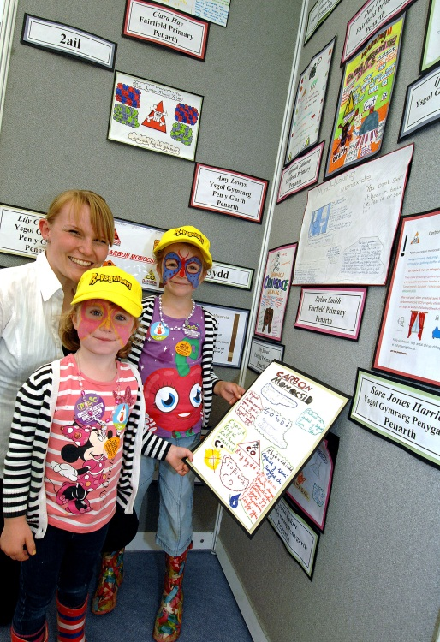
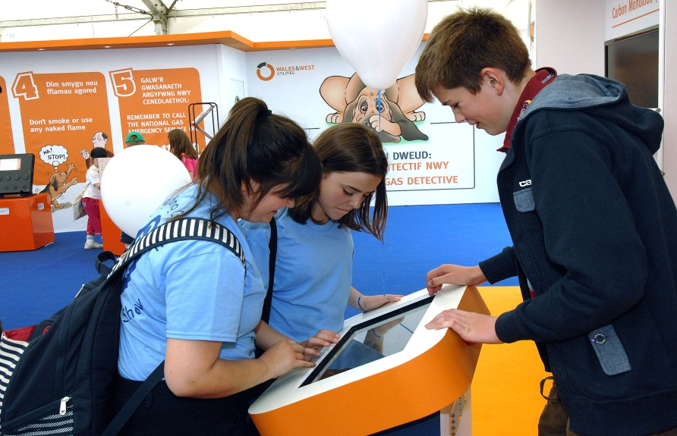
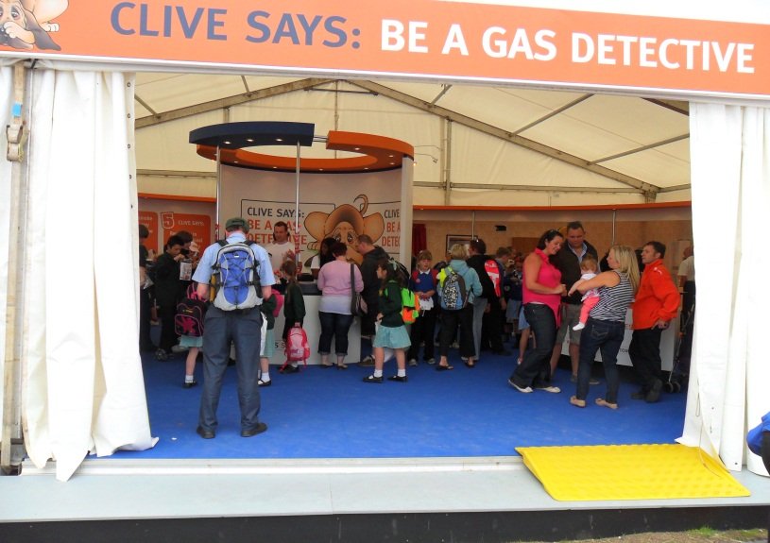
County Shows
  Over the course of the Summer, we engaged directly with over 4,000 families
  70% increased their knowledge
  And 88% committed to passing this important safety message onto a friend or family member
  Gold Medal Award winners for the stand of most educational value at the Royal Welsh Show

Slide 5
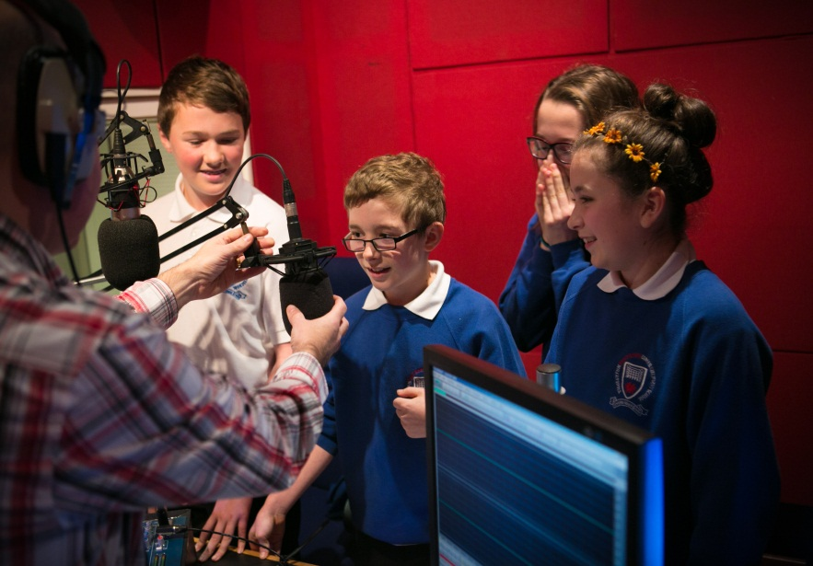
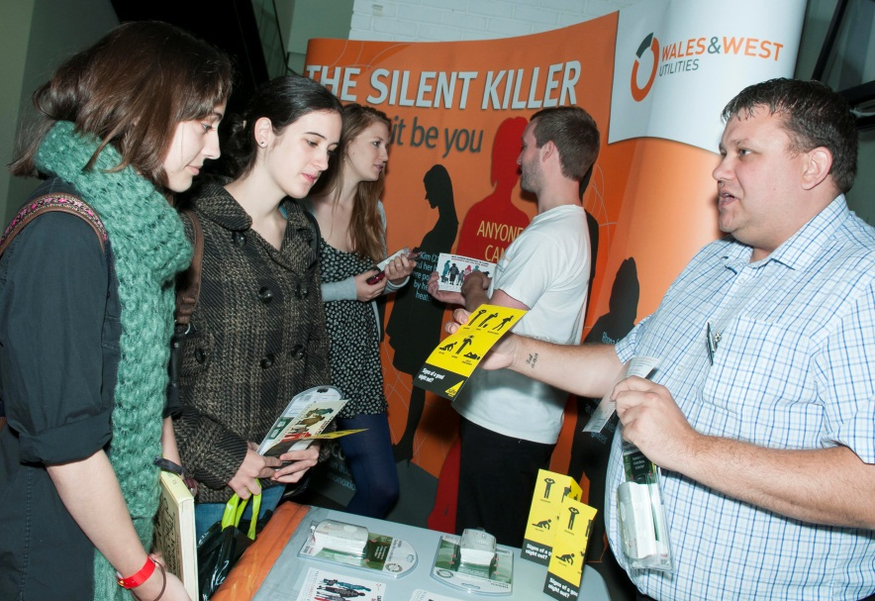
Other Initiatives...
We have a number of other initiatives targeting a wide cross section of society. Those relating to young people include;
Proud to be sponsoring a Wales section winner of the School Poster Competition
Developing our county show material to take into schools across our network
Working with the Guides to incorporate Carbon Monoxide awareness into the Home Safety badge
Working in conjunction with local radio on a competition for children to write and create their own CO campaign. Over the seven weeks on air, 238 trails were broadcast reaching over 240,000 listeners
Attending fresher's fairs to raise awareness with students and young people in rented accommodation

