Slide 1
CO-Gas Safety CO Awareness Competition
Registered Charity Number:1048370
www.co­-gassafety.co.uk
Calling all Primary School Teachers
Key Stage 1 and Key Stage 2 pupils
We want YOU!
Please help raise awareness of the dangers of carbon monoxide (CO) poisoning! CO-Gas Safety is an independent registered charity and is running a after Schools Awareness Competition for a ninth year to highlight the dangers of CO and other dangers from using fuel that burns.
The competition asks pupils to produce an informative, accurate and eye-catching poster, video, model, poem, story or anything that tells the dangers of CO warning of the dangers of Carbon Monoxide (CO) poisoning and/or fumes and/or how to avoid them.
Entry is FREE plus great CASH PRIZES!
There will be 10 regional prizes of £150 for the pupil &
£250 for the school plus one national winner
Competition for this year closes 31st May 2016
All teaching materials are on the website, including a downloadable
Power Point Presentation See http://tinyurl.com/p2q7epp

Slide 2
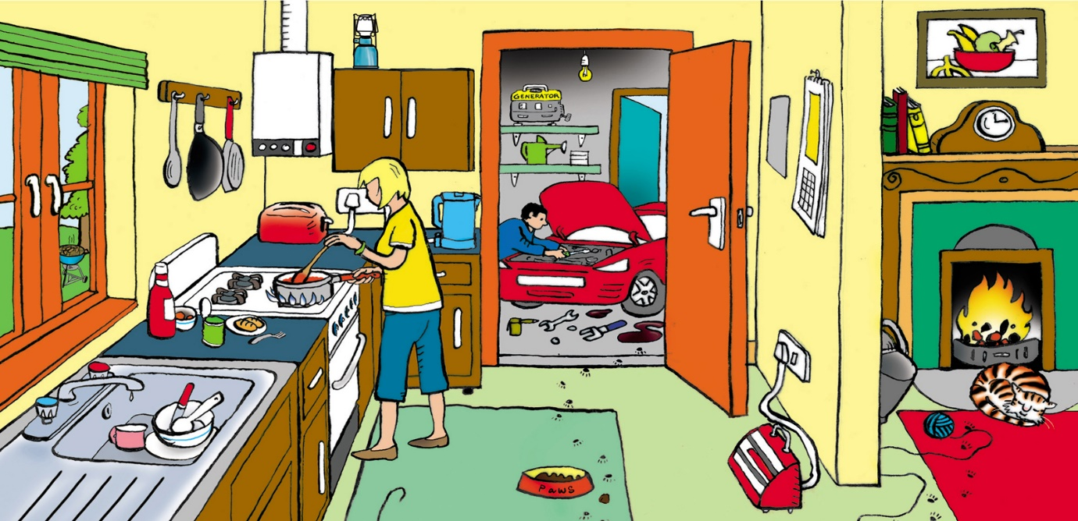
There will be 10 winners corresponding to the areas are now kindly sponsored by SGN, Wales & West Utilities, Northern Gas Networks and National Grid.
Teachers: You could ask your audience to spot the CO dangers in this picture:
For answers see www.co-gassafety.co.uk/answers
The charity is hoping for some brilliant entries to get the message across simply.

Slide 3
Map of the GDNs

Slide 4
SCHOOLS POSTER COMPETITION
INFORMATION ABOUT CARBON MONOXIDE
The Silent and Invisible Killer
Every year about 40 people in the UK are recorded as having died of carbon monoxide poisoning. Department of Health figures. A further 4,000 or so attend A & E,
Hundreds more suffer ill-effects as a result of exposure to carbon monoxide: sometimes they are permanently disabled.
Carbon monoxide can be emitted from faulty domestic
heating and cooking appliances. For our latest data see
http://www.co-gassafety.co.uk/stats_and_analysis.html

Slide 5
Tip of an iceberg
CO-Gas Safety believes that even these figures are the tip of an iceberg for many reasons:-
1. GPs rarely test for carbon monoxide.
2. Dead bodies are not automatically tested for carbon monoxide.
3. Heating and cooking appliances are often not tested for carbon monoxide and not tested for other products of combustion.

Slide 6
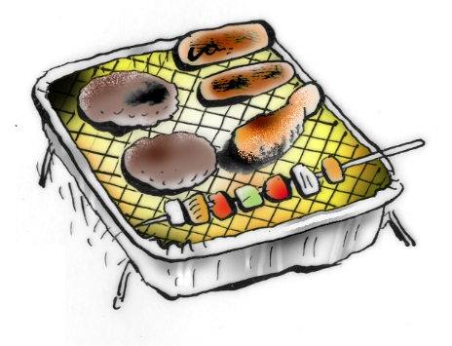
What is carbon monoxide?
Carbon Monoxide (CO) is a toxic gas, which can be emitted from the burning of any fuel.
Can you name any fuel that burns?

Slide 7
Can you find any possible sources of carbon monoxide in this picture?
Notes:
The coal fire is obvious as is the boiler and the gas stove. The generator in the garage and indeed the car are not so obvious.
The electric fire is a red herring as is the toaster unless the toast is on fire!

Slide 8
Why is Carbon Monoxide called CO?
The fuels that we use on a daily basis all contain carbon. Sources of carbon include, charcoal, oil, natural gas and petrol. When we burn these fuels the carbon combines with oxygen in the air. If there is enough air, carbon dioxide is produced. Carbon dioxide or CO 2 is formed from one atom of carbon and two atoms of oxygen.

Slide 9
Why is carbon monoxide called CO?
Carbon monoxide, CO is formed from one atom of carbon and one atom of oxygen.
So you can see that the less oxygen there is at the flame the more likely it is that carbon monoxide will be formed.
This is why it is so important to burn fuels in a
well ventilated area.

Slide 10
Why is carbon monoxide so toxic?
Carbon monoxide can also bind to the haemoglobin
but it doesn't break away again.
Effectively carbon monoxide blocks the haemoglobin
making it useless for carrying oxygen. This explains
why CO can poison in tiny amounts.
Notes:
Just 2% of CO in the air can kill in 1-3 minutes See HSE website http://www.hse.gov.uk/foi/internalops/hid/spc/spctosd30.pdf at Para 74 Table 23

Slide 11
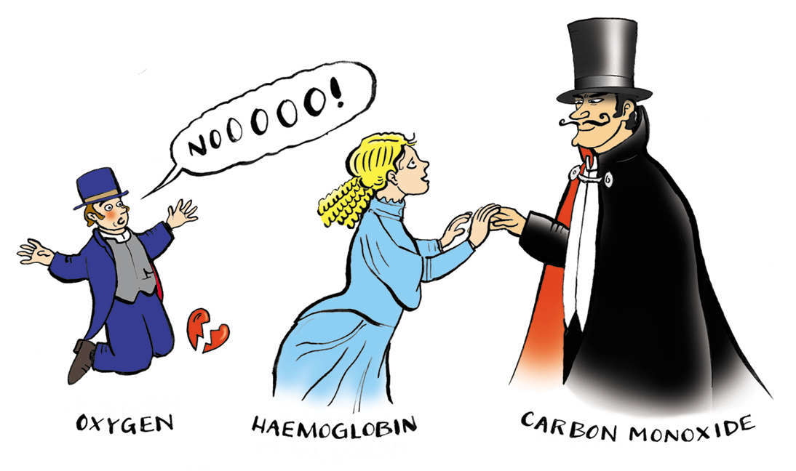
Haemoglobin is attracted to the deadly charms of Carbon Monoxide
CO cannot be sensed using human senses.
What are these?
Notes:
What are the human senses? Hearing, seeing, tasting and feeling.

Slide 12
How animals can help us
Did you know that miners used to take canaries down the mine?
Do you know why?

Slide 13
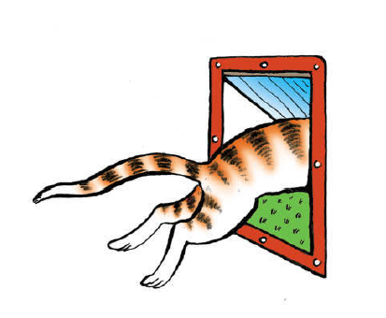
Notes:
Because the poor canary (being very small) would die first and this would alert the miners to the
presence of CO or other toxic fumes.
Cats sometimes die first because they are smaller than you but often they just go out if they sense CO.

Slide 14
How to tell if there is CO present
Please note that although you can't smell CO itself, you just might be able to smell some of the other products of combustion, which may have escaped into the room rather than gone up a chimney, (because it is partly blocked for example).
Sometimes people describe this smell as 'gassy' and think there has been an escape from a gas pipe supplying natural gas to the house or appliance.

Slide 15
How to tell if you have CO present
These days, special equipment, such as a Flue Gas Analyzer, is needed to test appliances and/or the air in a room for CO.
Animals can still warn of dangers in the home.
You may find your cat won't stay in the house.
Dogs may also behave strangely or have a sore throat or mouth. Vets are often good at diagnosing CO in dogs.

Slide 16
Research shows how widespread the problem is
Research undertaken by University College London in 2006 has found:-
23% of homes had one or more defective gas appliance;
2. 8% of homes were judged to be at risk of dangerous levels of CO; (equates to about 4.5 million people in the UK)
3. 45% of homes had received no information on the dangers of CO; and
4. A higher prevalence of problem appliances was found in the homes of vulnerable people
(young, old, those in receipt of benefits).
The above is taken from an HSE Press Release 02.10.06

Slide 17
Symptoms of CO poisoning
Can you guess what the symptoms of CO might be?
Notes:
You could write down the symptoms on the board that children give you and then compare with the next slide.
Please tell the children if they have got it right and congratulate them.

Slide 18
More research
More research has been done by John Moore’s university with similar findings but this research is still on going.
https://www.ljmu.ac.uk/about-us/news/life-saving-research-into-carbon-monoxide

Slide 19
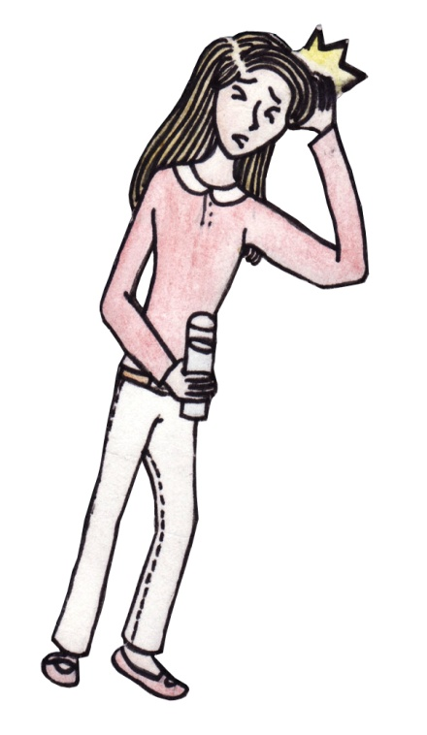
Symptoms of CO poisoning
All pictures illustrating these symptoms were kindly drawn for us by Chihiro Nagano, Winner of the South 2015. Thank you Chihiro!
Headaches
‘Flu like symptoms

Slide 20
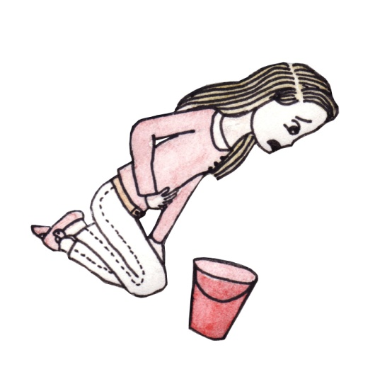
Symptoms of CO poisoning
Nausea, (feeling sick) and vomiting.

Slide 21
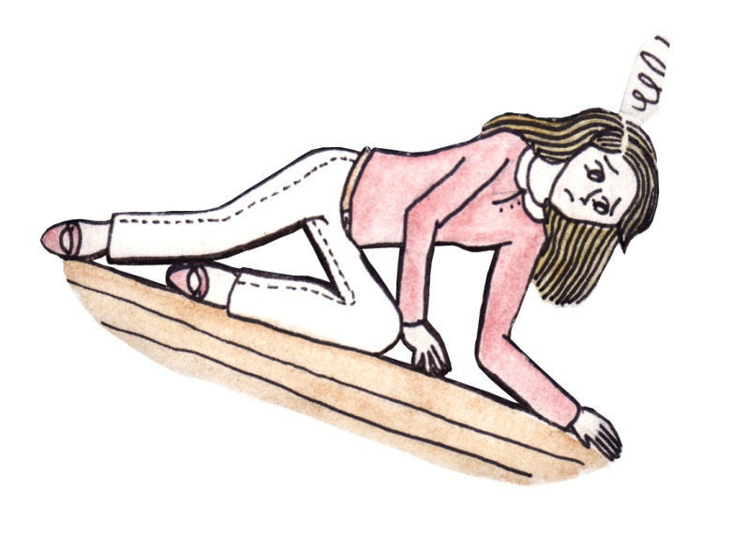
Symptoms of CO poisoning
Exhaustion, (feeling unnaturally tired)
Drowsiness, (wanting to go to sleep more than usual)

Slide 22
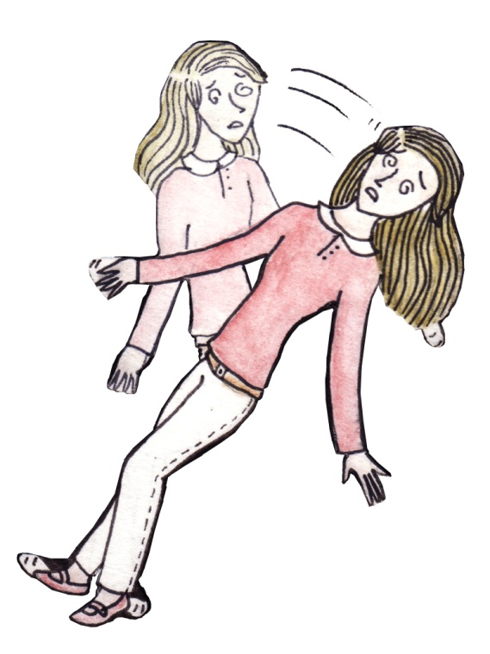
Symptoms of CO poisoning
Dizziness, (feeling funny as if you are going to fall over when standing up and perhaps feeling funny sitting down)

Slide 23
Symptoms of CO poisoning
Generally feeling unwell. Sometimes different members of the family can suffer different symptoms, some have headaches, some tummy aches or upsets.
Palpitations, (feeling your heart beat oddly)
Chest pain, (pain in your chest)

Slide 24
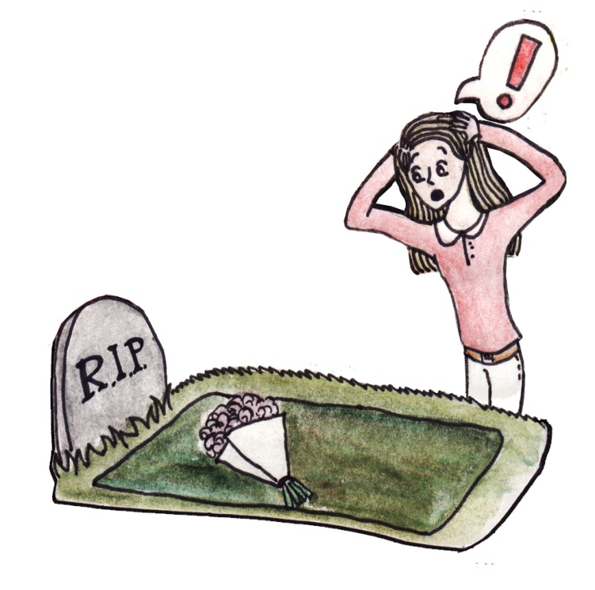
Symptoms of CO poisoning
Collapse without necessarily losing consciousness, followed by unconsciousness and perhaps death.

Slide 25
Who is most at risk?
The elderly and young are at higher risk than healthy adults. Possibly this is because they spend more time indoors, they are small (if babies etc.) or already ill (if elderly).
If you are suffering any of the symptoms, especially if more than one person in the house is suffering, you may be at risk of CO poisoning.
Notes:
The elderly and young are at a higher risk for several reasons.
They stay inside more. The elderly may already be ill and the young may be smaller.

Slide 26
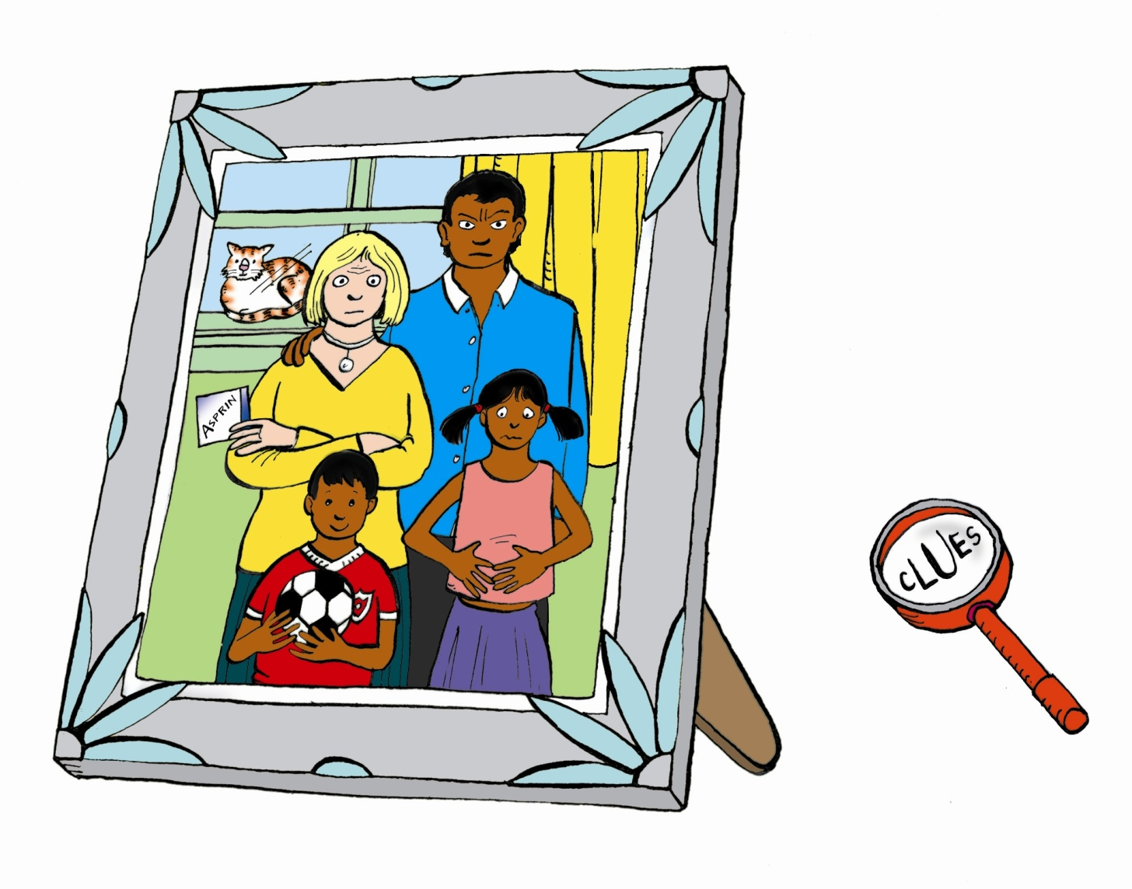
Different people suffer from different symptoms
Notes:
Ask the students to look at this picture carefully for clues.
Please bear in mind that family members can suffer different symptoms, for example, the mother may be tired and have a headache, (see the aspirin), the son may be dizzy and act strangely and always want to be out of the house, the daughter may have a bad stomach ache, while the father may just be bad tempered.
The problem is that such symptoms could be nothing or they could be CO.

Slide 27
Diagnosing CO poisoning
Doctors are generally poor at diagnosing CO.
The late Doctor John Henry, former Consultant Physician at the National Poisons Unit, surveyed 200 General Practitioners. He sent them symptoms of CO poisoning and requested their diagnoses. Although many sensible suggestions were made, not one GP suggested CO as a cause.

Slide 28
Diagnosing CO poisoning
Some doctors' surgeries have equipment, (sometimes called a Smokelysler or ToxCo), to analyse breath for CO. This is easy, painless and provides an instant result. If this shows CO, a simple blood test may be required to confirm the diagnosis. However, a blood or breath test can produce a falsely negative result if too much time has passed between exposure to CO and tests being carried out.
Do not assume that your appliances are safe, just because the test results were negative.
Notes:
Please note that arterial blood is NOT required for a CO blood test. Some GPs think it is and this is off putting and painful.

Slide 29
What do you do if you suspect you’ve been exposed to CO?
Notes:
Ask the students and perhaps write these answers on the board and then go to the next slide.

Slide 30
What do I do if I suspect I’ve been exposed to CO?
1. Get out of the house or place where the poisoning is occurring (e.g. workplace, garage, etc.) or if you can't do this
2. Open all windows and doors and turn off all appliances.

Slide 31
What do I do if I suspect I am being poisoned?
3. Call the Gas Emergency number on 0800 111999 (e.g. from a neighbour's house)
4. Get to your GP or to the Accident and Emergency department at a hospital as soon as possible and ask for an immediate blood or breath test for CO. Find someone to go with you if possible. Arterial blood is NOT necessary. A visit to a doctor may also be helpful to prove CO poisoning or at least to record symptoms suffered by you that are consistent with CO poisoning. If exposure to CO is severe, treatment with hyperbaric (high pressure) oxygen is often recommended.

Slide 32
What do I do if I suspect I am being poisoned?
5. If you wish to find out which gas appliance has been emitting CO you contact the Gas Safe Register for a registered gas installer qualified under CMDDA1 to test each gas appliance and if he or she finds any CO, to give you the parts per million of CO in writing.
This may be helpful to your doctor or for a legal case, although you may need a special court witness to investigate for a legal case.

Slide 33
Can CO pass between houses?
Yes, through a joint chimney for example. Alternatively CO or other products of combustion can leak from the flat above or the flat below. People have even died from CO from another house or flat but this is rare.
Please note that the National Gas Emergency Service, (responsible for gas emergencies) has no equipment to trace CO although they do now have Personal Alarm Monitors or Gasco seekers for CO.

Slide 34
Finding the CO
If you call the gas emergency service they will ask you to turn off all appliances and open the windows and ventilate.
If one of your appliances was emitting CO, the First Call Operative’s equipment to react to CO is very unlikely to pick up any CO unless it is coming from an unsuspected appliance left on (e.g. wood burner) or from next door.

Slide 35
Beware wood pellet/chip stores
Notes:
Wood pellets in store can emit carbon monoxide even though the pellets are not burning
http://www.hse.gov.uk/safetybulletins/co-wood-pellets.htm

Slide 36
Wood pellets
Wood pellets in store can emit CO, even if not burning.
http://www.hse.gov.uk/safetybulletins/co-wood-pellets.htm

Slide 37
Wood pellets
Since 2002 there have been at least nine fatalities in Europe caused by carbon monoxide poisoning following entry into wood pellet storage areas.
Do not enter or put your head inside wood pellet stores.
Any such store should be well ventilated.

Slide 38
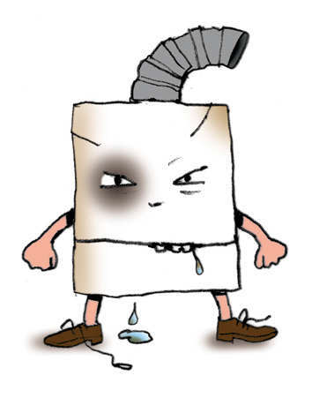
How safe is your boiler?

Slide 39
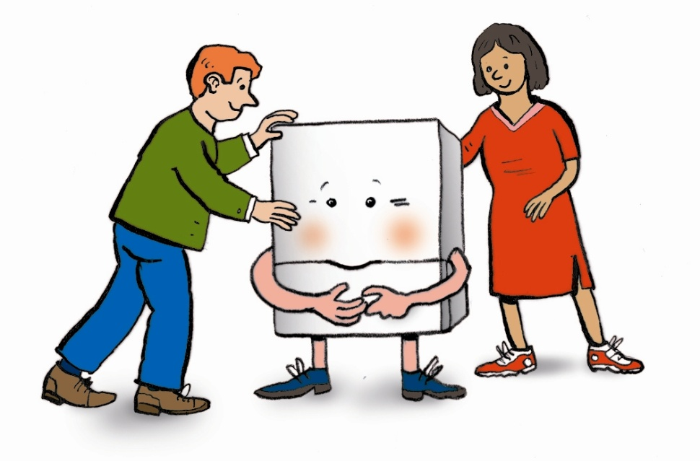
Take these simple steps to CO safety - it's just commonsense!!
1. Look at all your appliances. Do they look unsafe? They should look clean (i.e. no soot or dirt around it and no water leaking from it) and burn with a blue flame.

Slide 40
Take these simple steps to CO safety - it's just commonsense!!
2. Make sure the person who is maintaining your appliance is properly qualified.
Consider the fuel the appliance uses. Is it coal, wood, oil or gas?
If it is a gas appliance, check with Gas Safe Register to make sure they are qualified http://www.gassaferegister.co.uk/
Tel. +44 (0)800 408 5500
Notes:
Don't be shy about asking for proof of their training and experience - it's your money and your life. Ensure that your gas fitter uses a flue gas analyser or similar equipment to check for CO gas.
Don't be shy about asking for proof of their training and experience - it's your money and your life.
Ensure that your gas fitter uses a flue gas analyser or similar equipment to check for CO gas.

Slide 41
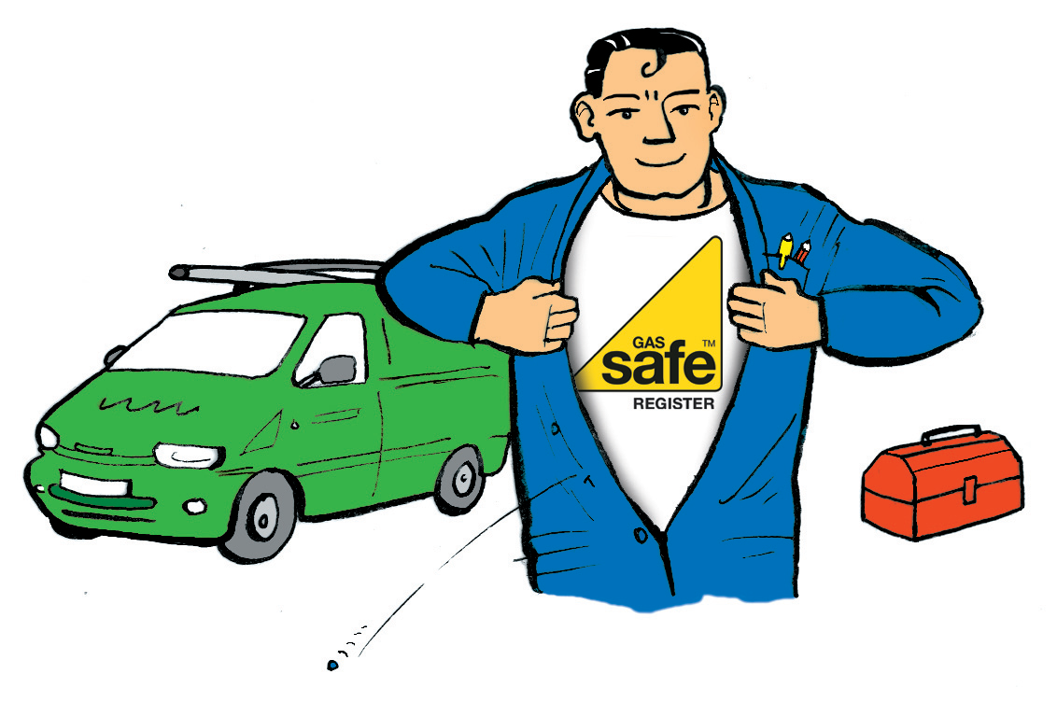
Take these simple steps to CO safety - it's just commonsense!!
For gas appliances the law requires that only someone who is Gas Safe Registered should inspect or service them.

Slide 42
Take these simple steps to CO safety - it's just commonsense!!
3. Make sure chimneys and flues are swept regularly, at least once a year, by a fully qualified Sweep.
Notes:
Make sure the chimney does not end in the loft or leak into the loft. It is important that chimneys and flues are kept clear so that all the products of combustion go harmlessly up the chimney and not back into the house.

Slide 43
Take these simple steps to CO safety - it's just commonsense!!
4. Do not block vents or air grilles. Make sure you have some ventilation (open a window).
If there is enough oxygen reaching the flame carbon dioxide will be formed, NOT carbon monoxide.

Slide 44
Take these simple steps to CO safety - it's just commonsense!!
5. As an extra safeguard buy a CO alarm to European Standards EN50291 - Cost around £15-£20. Alarms are available at most DIY shops and some supermarkets. It is extremely rare to die with a CO alarm which was in date although one person did ignore the alarm. However, we have heard of people still feeling ill with a good alarm, perhaps from low levels of CO or from other products of combustion such as nitrogen oxide or other toxins in fuel (see http://www.cogassafety.co.uk/other_toxins.html )

Slide 45
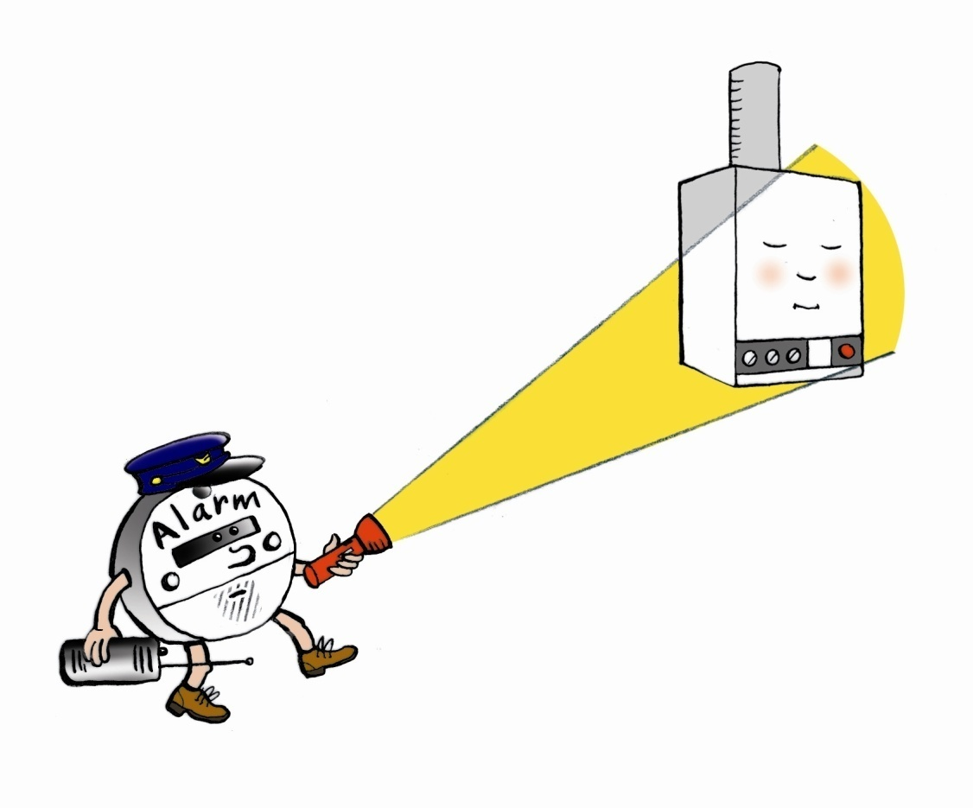
Take these simple steps to CO safety - it's just commonsense!!
Remember a smoke alarm is NOT a CO alarm.
A CO alarm is NOT a smoke alarm.

Slide 46
CO-Gas Safety poster competition
Apart from the Illustrations of symptoms by Chihiro Nagano all other illustrations are by
CO victim, children’s illustrator and paper
engineer, John O’Leary www.oleary-irsara.com
Without your help this poster competition
wouldn’t have been possible. Thank you for
your endless help.
© 2015 Copyright CO-Gas Safety

