Slide 1

CO-Gas Safety
PPP to Energy UK 18.12.15
Stephanie Trotter, OBE, President & Director
Frank Brehany, Holiday Travel Watch
Sue Westwood- Ruttledge – carbon monoxide survivor/ victim
Notes:
Good afternoon and thank you for allowing me to address you.

Slide 2
Thank you for letting us address you
How Stephanie became involved in safety:
Alex Trotter (older son), aged 12 , suffered brain clot in 1991 during children’s activity holiday
Stephanie wrote to MP asking for controls
Was told there were guidelines…
Notes:
How I got into all this.

Slide 3
Children’s Activity Holidays
4 Teenagers drowned, Lyme Bay , March 1993
Wrote New Law Journal article in 1994 advocating licensing children’s activity holiday centres
Read by Judge, Mr. Justice Ognall, & all case barristers

Slide 4
Children’s Activity Holidays
OLL Ltd & Peter Kite prosecuted for manslaughter by gross negligence
Kite received 2 yrs imprisonment & £60K fine
Led to Activity Centres (Young Persons’ Safety) Act 1995 licensing centres for safety.

Slide 5
From holidays to CO-Gas Safety ..
Introduced to Molly Maher:
Gary, Molly’s son, died in Tenerife from CO in ‘85
Sheree, Molly’s daughter, confined to wheelchair
CO-Gas Safety launched 25th Jan ‘95 at House of Commons

Slide 6
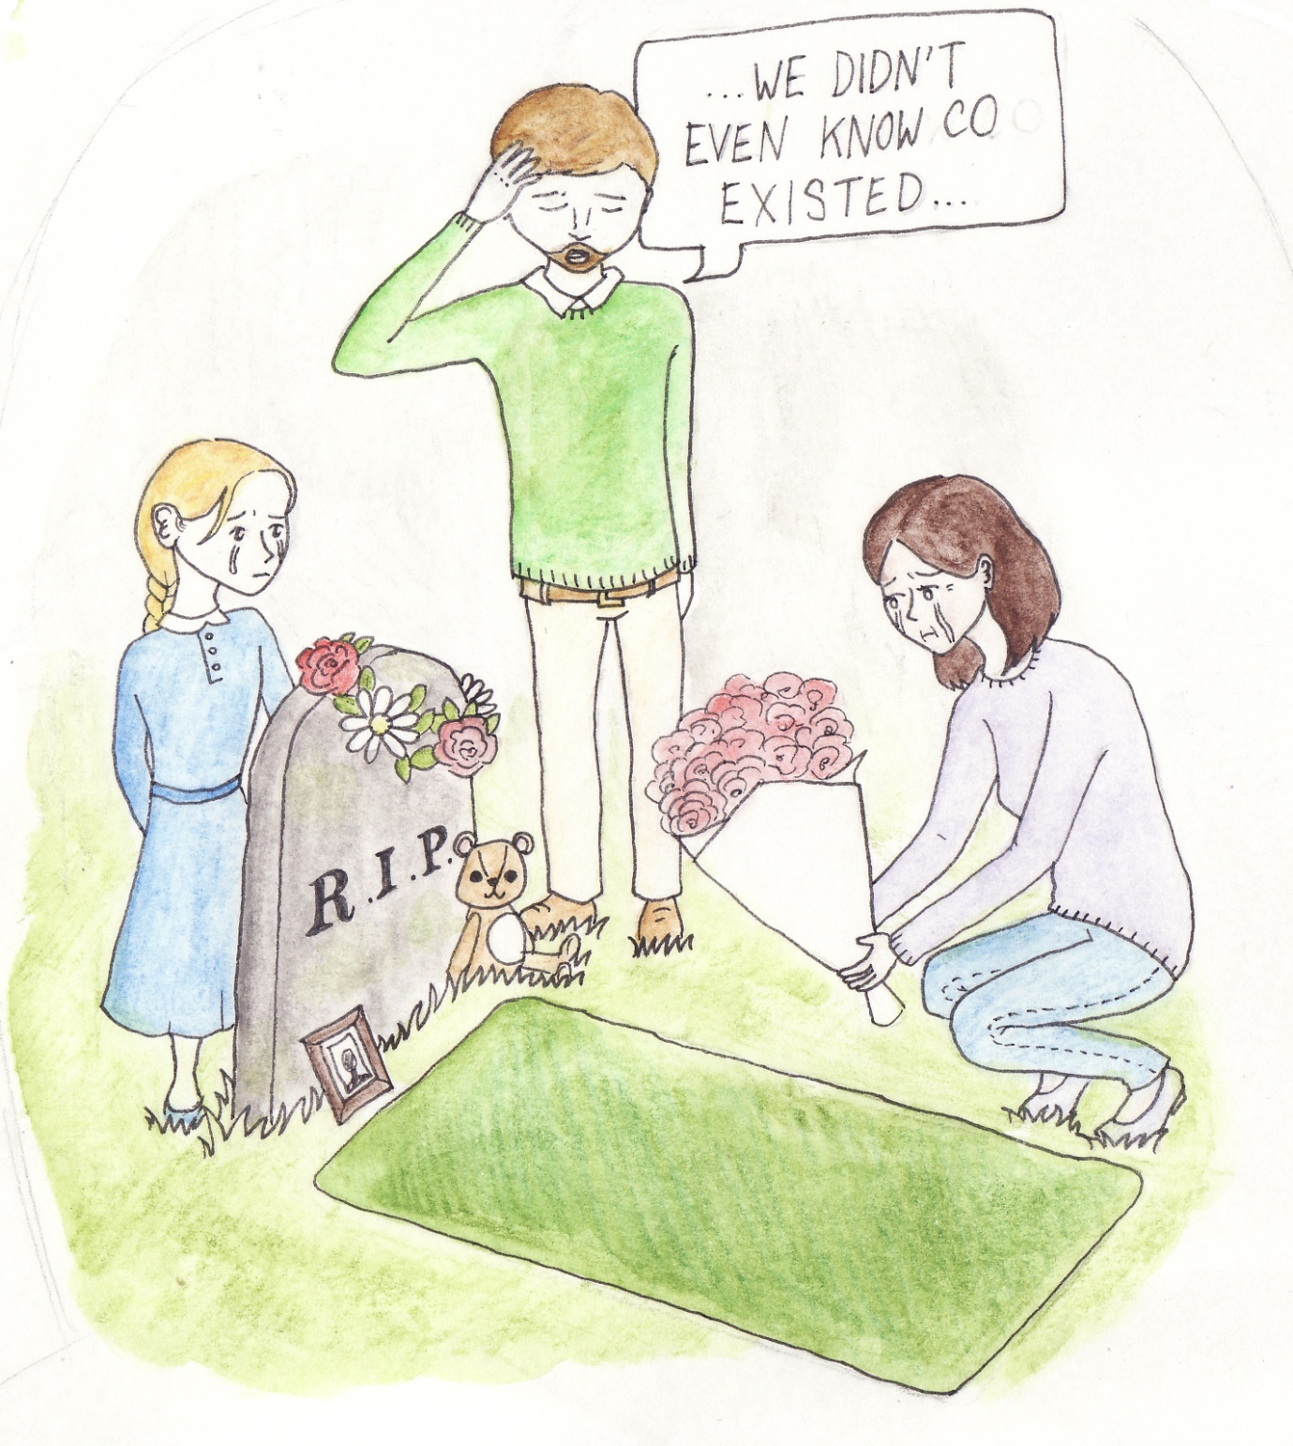
Stephanie knew nothing about CO so talked to families
Notes:
Within a matter of weeks I realised that lack of awareness was key.

Slide 7
From victims, we learnt:
Awareness key – called for prime time TV warnings about CO in 1995 and ever since
Energy UK’s recent research confirms need – delighted to see
But in cases where CO registers:-
Gas Emergency Service can’t test appliances for CO
Ordinary registered gas installers won’t test for CO - Most not trained to do so
Notes:
Energy UK’s recent research and campaign.
30 million people living in the UK are currently at risk from carbon monoxide poisoning.
Nearly half of all people living in the UK fail to have their boiler checked annually.
70% of people did not know their CO alarms had an expiration date.

Slide 8
Without Parts Per Million of CO
Survivors receive wrong medical treatment
No proof of CO
Little data (no RIDDOR) SO ..
No safety improvements
Yet Baroness Finlay says CO deaths & injuries cost UK taxpayer £178 million / year*
* Cost benefit analysis, p. 12, 2015 press pack http://www.co-gassafety.co.uk/resources/press-pack-2015/

Slide 9
Lobbied Government
Recommendations by HSC in 2000:-
Levy on gas suppliers to raise awareness & undertake research
&
Gas emergency service to carry & use equipment to test gas appliances for CO
Yet NEITHER implemented
Notes:
HSC is the Health & Safety Commission (now Executive).

Slide 10
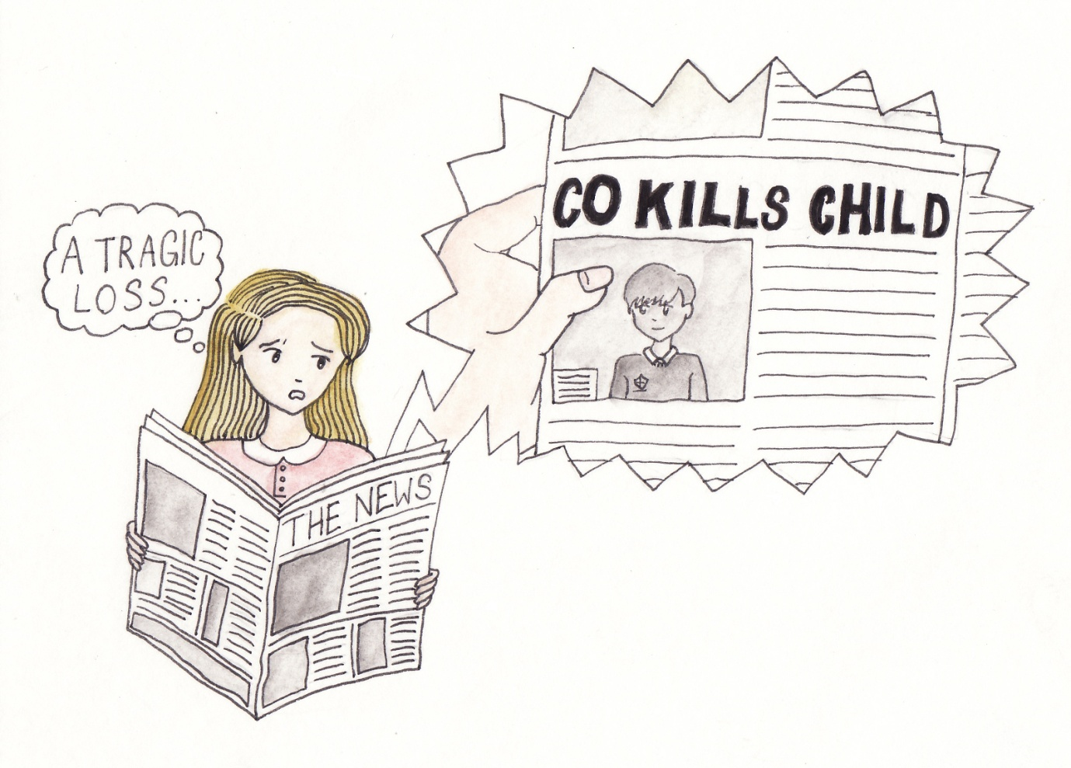
Work
Notes:
Data collection started in 1995

Slide 11
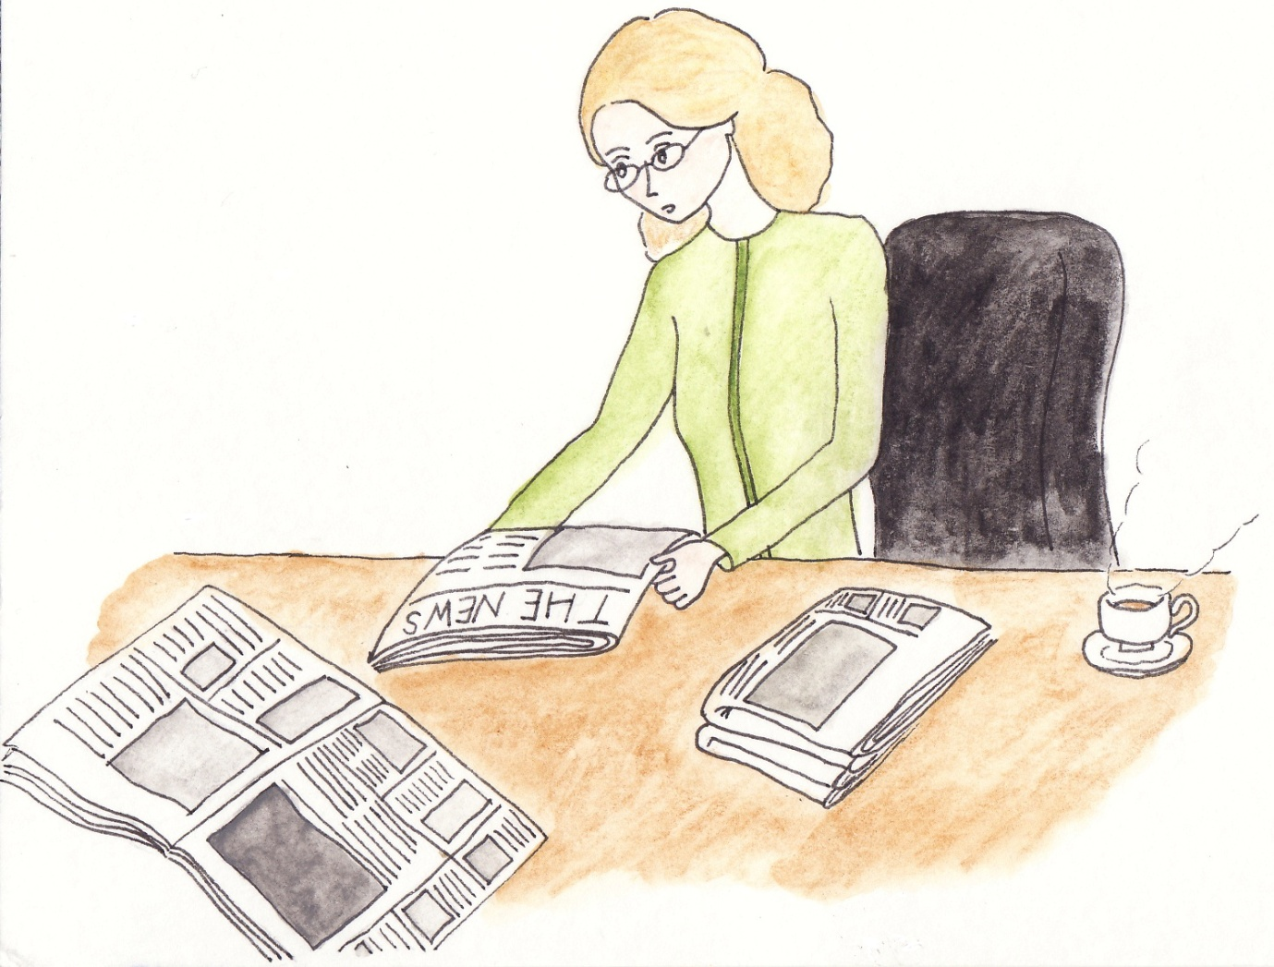
Work
Notes:
Asked industry to make improvements and to pay for prime time TV warnings but no progress.

Slide 12
CO Challenges
CO kills quickly within minutes – Fireman talk about 3 breaths in smoke, which you can smell
CO leaves body quickly so testing person leads to danger of false negative
No automatic test of dead bodies for CO
So Catch 22 – to prove CO you need to prove CO
Industry makes it almost impossible to obtain a test on appliances - leads to assumption CO only affects low numbers
Impact huge - see press pack’s p.10 for numbers affected
Notes:
See page 2 of your handout material for HSE website reference re death from CO within 1-3 minutes.
See page 3 of handout for difficulties on CMDDA1

Slide 13
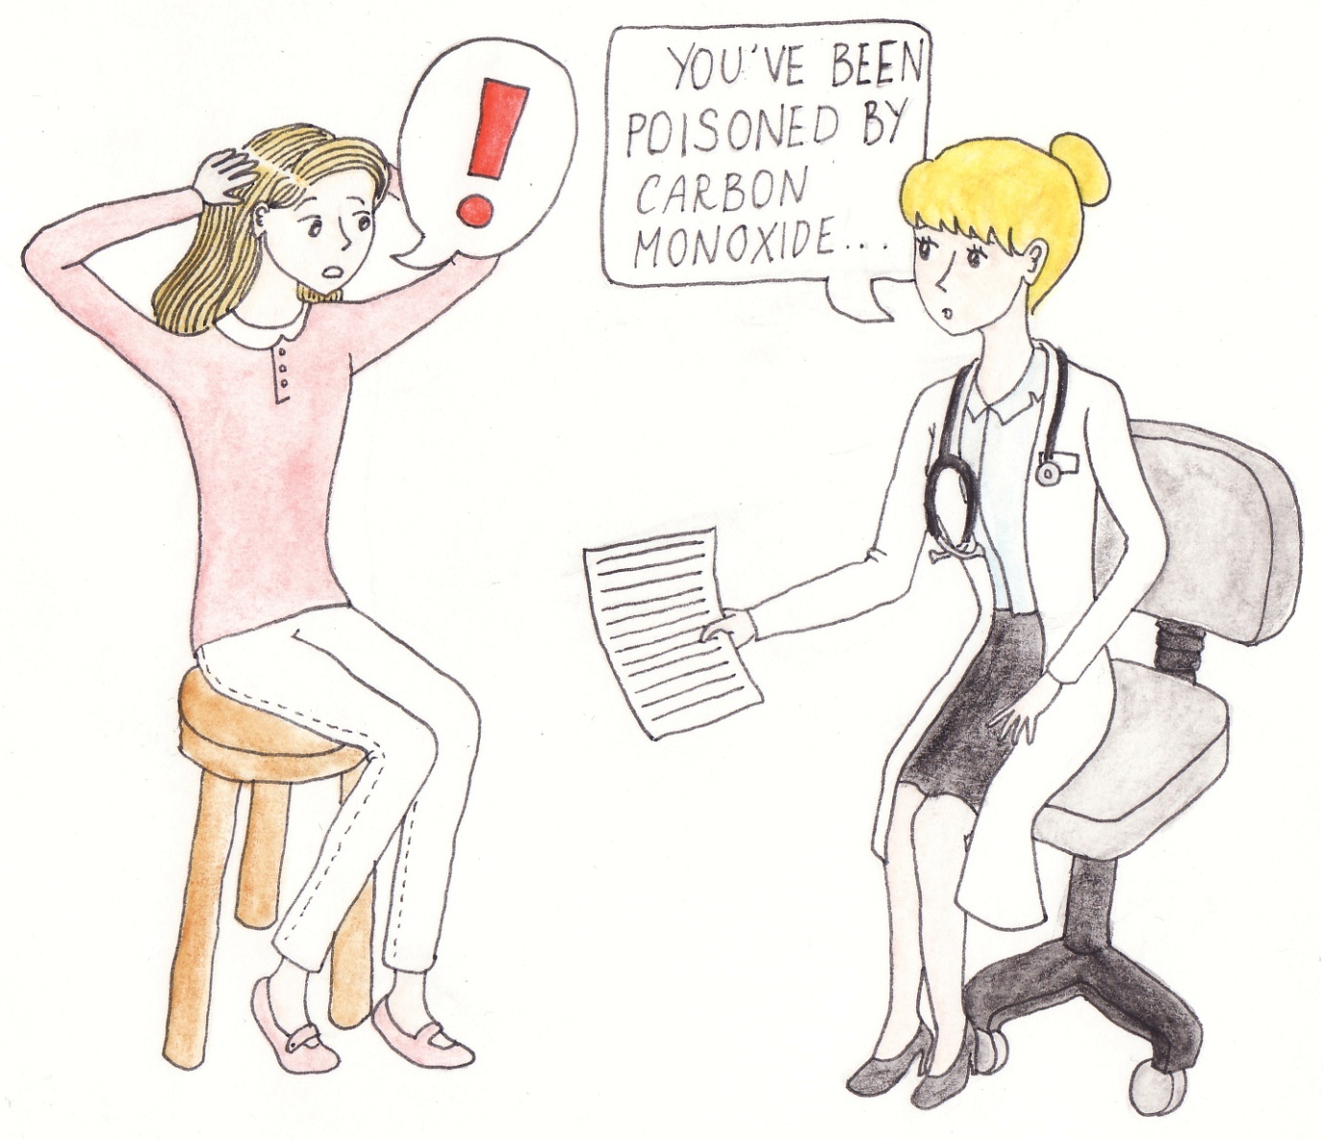
If only…
Notes:
Diagnosis by GPs and Medics almost never happens. Can count number of GPs who diagnose on fingers of one hand. Medics hugely unaware.

Slide 14
Sue Westwood-Ruttledge
Poisoned by boiler for 3 years
Doctor didn’t suspect CO
Thought she was suffering from dementia
Notes:
See pages 11-16 in handout for article in the Mirror.

Slide 15
Dr Ben Croxford UCL 2006 see pages 4-5 of handout
  23% homes had 1 or more defective gas appliance;
  8% of homes judged at risk of dangerous CO levels;
  p.10, 2015 Press Pack – 3-4 million?
  Other research similar – see handout:
  John Moore’s, Dutch Safety Board, p. 3
  Smart Compliance, p. 5
  Energy UK research, p. 6–7
Notes:
http://www.onderzoeksraad.nl/uploads/phase-docs/1080/ffe8e9293c28summary-koolmonoxide-en.pdf
You Tube film
https://www.youtube.com/watch?v=EgL74t_COV0
Cost of units about £45. Unit is £45 and 50 pence per week for commission, portal, set up, and administration.
At the moment it is suitable for large landlords . Minimum for number of units for monitoring is 300 units
A pay as you go version for private residents is in development
30 million people in the UK at risk of CO.
Only half had boilers checked.

Slide 16

I had to do something!

Slide 17
Work by CO-Gas Safety
Awareness –
Prime time TV warnings but none done so launched Schools Poster competition in 2006
Now CO awareness competition for primary school kids - See flyer, handout p. 17 & teacher PPP
Helping victims - Collecting & publishing data & safety improvements
Matthew Nixon
Notes:
Standard for CO alarms. CMDDA1. Matthew Nixon – registered gas installer aged 22 died of CO from using a petrol generator to power his tools. Found when offering victim support to his mother that he had been in the gas industry for 6 years. Led to a course about CO by Roland Johns, certificated by BPEC and taught to some GDN staff.

Slide 18
From victim support to data
Collecting data for 19 years since 1995
In 19 years we’ve found 677 deaths from unintentional CO – checked with Coroners & independent statistician twice
In 19 years - over 4,700 near misses/injuries
See Press pack, p. 20-33 - pie charts, etc

Slide 19
Our data
We know only receive tip of iceberg - No automatic blood test on death for CO
3,500 people between 16 & 64 die of unexplained causes every year in UK & not tested for CO – Dr Mary Shepherd*
*‘Killer with no name’, New Scientist, 2004
Gas Safety Trust is testing all dead bodies for CO in 3 Coronial areas.
Notes:
The numbers will come out.

Slide 20
Endless lobbying – small success
Gas emergency service FCOs equipped with CO Personal Alarm Monitors (PAMs) leading to data. We are told GDNs will publish ..
Data from victims needed anyway
Our data so far shows gas is much safer, per user, re CO deaths than other fuels
Great News for Gas !
Notes:
But with an emergency call consumers are told to turn everything off and open the windows – even then PAMs have alarmed from unsuspected appliances, next door etc.

Slide 21
Our data & other issues
All want our data but NO secure funding
No victim support other than small charities like CO-Gas Safety
Some awareness but must be sustained, cover all fuels, appliances & accommodation types
Notes:
All fuels (gas to wood), all appliances (boilers to barbecues) and all types of accommodation (bungalows to boats).

Slide 22
The tour industry
Many years, particularly 1995-2000, meeting tour industry to persuade them to improve safety
See article ‘Holidays: risks of the Trade’, Handout p. 21-22 & Lindy’s account, p. 19-20
Asked by Safety Director, leading Tour Company: “We’re sending people to death traps – What should I do?”
Notes:
Advice to the safety director who was sending people to death traps. Write memos to all the directors informing about unsafe accommodation – don’t expect to keep your job.

Slide 23
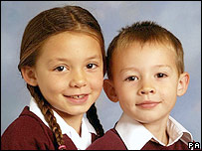
Corfu tragedy 2006
Deaths of Christi & Bobby Shepherd
Notes:
While on a Thomas Cook holiday – Christi aged 7 and Bobby aged 6.

Slide 24
Corfu tragedy 2006
I contacted hospital
I contacted family
I recommended Harry Rogers, Gas Expert Investigator
Harry went to Corfu & gave evidence at inquest
I recommended Leslie Thomas, now a QC, to represent family at inquest.
Without our help & Parents’ determination we doubt facts would have come out
Notes:
Without our help & parents’ determination we very much doubt if the facts would ever have seen the light of day.

Slide 25
Corfu inquest – May 2015
Jury found breach of a duty of care by Thomas Cook – most unusual in an inquest
TC mismanaged case - An example how a large corporation can get it incredibly wrong
See hand out articles, p. 21-23
Donations made included CO-Gas Safety
Notes:
Donation great but sadly not enough to change the charity’s way of life.

Slide 26
The Future
Foundation for Safer Tourism set up with £1m
Hopefully things will improve – won’t they .. ?
But what about UK’s CO deaths & injuries & role of fuel suppliers?

Slide 27
Tour Operators & Energy Industry
CO-Gas Safety, Consumer Safety International & Holiday Travel Watch warned Tour industry & ABTA but ignored for decades
See handout, p. 21-22
Apart from some help from GDNs & last autumn’s Energy UK campaign & research, Energy Industry has not done much
Please take action NOW!

Slide 28
What we need
Support and funding for our work:-
Industry funded Prime time TV warnings – e.g: Network Rail level crossing campaign
Industry funded Data collection & publication – approx £50K / yr
Industry funded Victim support & lobbying for safety improvements – approx £30K/yr

Slide 29
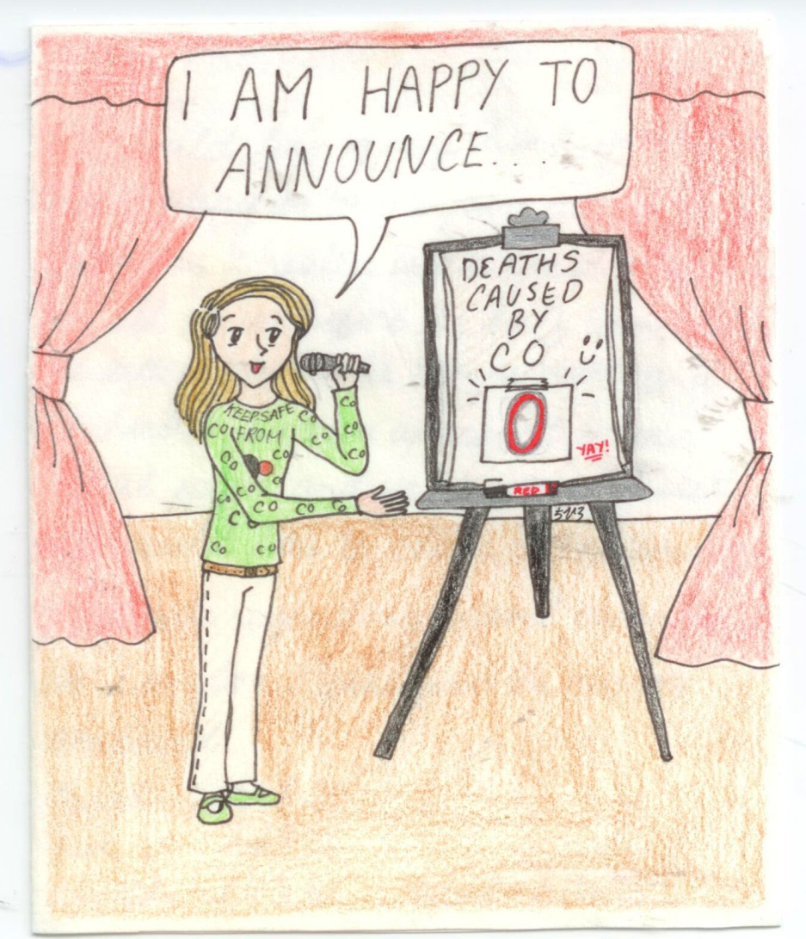
What I want
Notes:
Many people wonder why I do this work. It took an eleven year old winner of our competition to just get it without even talking to her about it – she had merely attended our 20th anniversary event at the House of Lords. This is her thank you card.

