Slide 1
CO-Gas Safety
CO-Gas Safety is an independent, registered charity committed to reducing unintentional carbon monoxide (CO) poisoning and helping victims and their families.
Stephanie Trotter, OBE, President & Director
I have run the charity as a volunteer since its launch in 1995.
Notes:
Good afternoon and thank you for allowing me to address you. I became interested in safety after our son was injured at an activity holiday centre and was successful in helping to change the law to licence such centres.

Slide 2
Corfu tragedy 2006 - Thomas Cook Deaths of Christi & Bobby Shepherd Inquest 2015
Notes:
This tragic case received massive publicity but it isn’t just holidaymakers abroad who die. For our part see our leaflet part in green on last page of leaflet http://www.co-gassafety.co.uk/wp-content/uploads/2015/12/CO-Gas-Safety-leaflet-about-carbon-monoxide-poisoning-30.10.15-3.pdf

Slide 3
Carbon Monoxide and Carbon Dioxide CO and CO2

Slide 4
Where does CO come from?
Faulty cooking and heating appliances powered by any carbon based fuel can emit CO.
CO cannot be sensed by human senses of smell, taste, touch or sight.
Less than 2% of CO in the air can kill in between one and three minutes.
Notes:
3 breaths.
http://www.hse.gov.uk/foi/internalops/hid_circs/technical_osd/spc_tech_osd_30/spctecosd30.pdf see Para 74 table 23 page 26
12800 ppm Immediate effect, unconscious after 2 to 3 breaths, danger of death in 1 to 3 minutes
Please note that 12800 Parts Per Million of CO in the air is less than 2%

Slide 5
Spot the appliances!
Notes:
Appliances on Cooker, solid fuel open fire, possibly boiler on wall of kitchen
Appliances not on but possible sources of CO if on, Car and generator in garage, camping lamp in kitchen and barbecue outside seen through window.

Slide 6
DoH
40-50 deaths and 4,000 to A & E in England & Wales
Link to 50 deaths 4,000 A & E
https://www.gov.uk/government/news/carbon-monoxide-poisoning-sends-4-000-people-to-a-e-each-year
But who knows?
Reason statistics are not reliable?

Slide 7
Could a death be from CO?
To test or not to test - that is the question.
How much does it cost?
Baroness Finlay co-chair of APPCOG has recommended that all dead bodies are tested for CO.
3,500 people between ages of 16 & 64 die of unexplained causes every year in UK & not tested for CO – Dr Mary Shepherd*
*‘Killer with no name’, New Scientist, 2004

Slide 8
Testing the dead for CO
Testing survivors is very difficult because fresh air will reduce the CO in the breath and blood
In contrast testing dead bodies is very reliable unless decomposed.
If cost is an issue we or other wealthy charities could help.

Slide 9
Deaths & injuries from CO
We collect data of deaths & injuries from unintentional carbon monoxide poisoning.
Can be downloaded from our website under data http://www.co-gassafety.co.uk/data/
All in our press pack 2016
http://www.co-gassafety.co.uk/resources/press-pack-2016/
We are most grateful to Coroners & their officers for their help.

Slide 10
Form on our website
Can be filled up online or downloaded and posted back to us.
Asks questions that perhaps helps Coroners to gather the right evidence if they haven’t dealt with a CO death before. For example, had the appliance been serviced within the last year? Was a CO alarm to EN 50291 present?

Slide 11
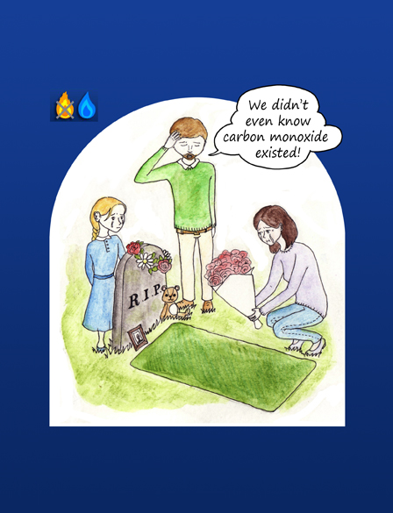
Picture by Chihiro Nagano 11 year old winner of CO-Gas Safety’s CO Awareness poster competition 2014 © Copyright CO-Gas Safety 2016

Slide 12
Petition for prime time TV warnings
CO-Gas Safety has been lobbying since 1995 about the dangers of carbon monoxide poisoning
Please sign our petition
for prime time TV warnings
https://petition.parliament.uk/petitions/124796
Share with your friends and family
Please pass it on to all UK citizens!
Thank you
Petition runs until 20th September 2016

Slide 13
END Copyright CO-Gas Safety 2016 www.co-gassafety.co.uk Email office@co-gassafety.co.uk

