Slide 1
CORT
- Making Sense of CO Exposure
- Lived experience of survivors
- Understanding experience of underserved communities
Thank you Adrian & Dr Connolly for invite to talk 16.10.24

Slide 2

Stephanie Trotter, OBE
President & Director of
Independent Registered Charity
CO-Gas Safety
Reduce deaths & injuries from unintentional CO
Help victims & families
Run charity since 1995, helped by voluntary directors - mainly survivors/victims & families
www.co-gassafety.co.uk

Slide 3
How much do you know about CO?
We all know something
BUT
Most of us don’t know everything.
So, here’s a nutshell on CO

Slide 4


Carbon Monoxide (CO)
Carbon Dioxide (CO²)
CO
1 atom of carbon to 1 atom of oxygen
CO²
1 atom of carbon to 2 atoms of oxygen
Notes:
CO is 200 times more attractive to the haemoglobin in the blood than oxygen.

Slide 5
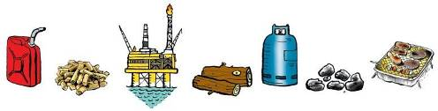
Where does CO come from?
How is CO created?
A product of combustion - Smoke in fires
Also, in products of combustion from faulty appliances using carbon-based fuels that burn
Includes Gas, Coal, Wood, Petrol, Diesel etc.
Notes:
Gas, coal, petrol, diesel, wood etc.
Firefighters when talking about smoke which you can smell says it only takes three breaths, at the first you don’t know there is anything wrong, at the second you may suspect something but by the third you are incapable of doing anything.

Slide 6
How is CO created?
Insufficient oxygen at flame = CO, not CO²
CO cannot be sensed via smell, sight, hearing or touch
Less than 2% CO in air can kill in under 3 minutes

Slide 7
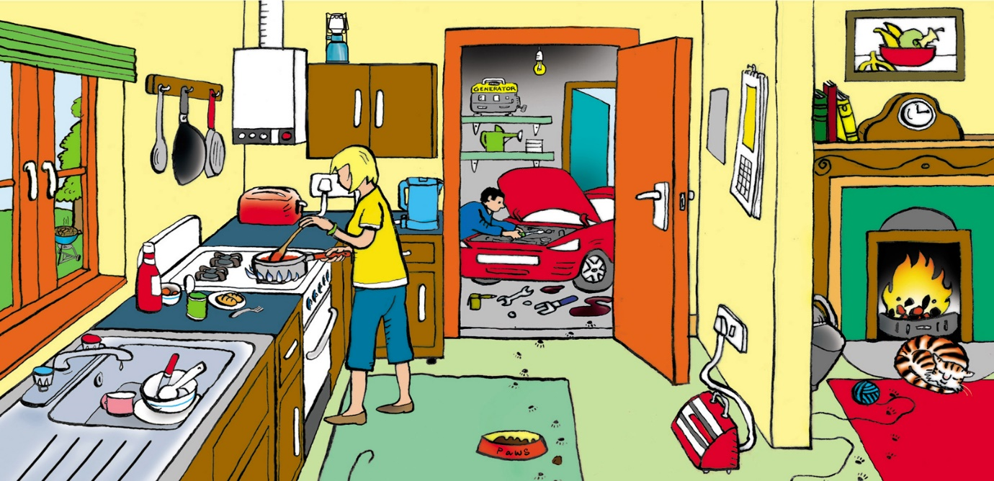
Spot the appliances that could emit CO!
Notes:
Appliances on - Cooker, solid fuel open fire, boiler on wall of kitchen
Appliances not on but possible sources of CO if on, Car and generator in garage, camping lamp in kitchen and barbecue outside seen through window.

Slide 8
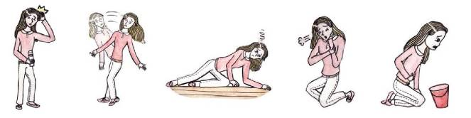
Symptoms of CO
Low CO levels over long periods can cause symptoms, similar to virus, but typically no raised temperature
HEADACHE DIZZINESS TIREDNESS BREATHLESSNES NAUSEA

Slide 9
Diagnosing CO poisoning
Breath or blood test BUT usually too late
CO leaves breath & blood quickly BUT continues to injure even when survivor in fresh air/treated with oxygen - Huge danger of false negative
Survivors/patients - very difficult for medics
A&E Blood gas machines test for CO BUT
medics assume CO is rare & don’t always look
CO is stable in a dead body – BUT no automatic testing for CO, even at PM
Notes:
Blood does NOT have to be arterial blood.

Slide 10
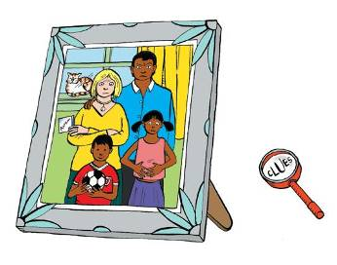
Different family members can have different symptoms

Slide 11
Symptoms of CO
What is downside of asking patient & looking for CO symptoms?
Answer
Symptoms common to many viruses, etc
Patient may die if you send home saying return next week if still unwell

Slide 12
Algorithm for GPs
https://assets.publishing.service.gov.uk/media/5a7568fb40f0b6360e473e60/CO_diagnosis_algorithm_2015.pdf
Does advise breath or blood test
BUT disadvantages of breath/blood test?

Slide 13
Algorithm for GPs
Says ‘DO NOT allow your patient to go home without a warning NOT to use the suspect appliances.’
Will patient suspect gas cooker, wood fire, car in garage, bucket of ash in kitchen?
Box 4 If the patient does not improve:
• contact the NPIS for advice
• contact your local PHE centre for advice
* Reconsider diagnosis
What is missing?

Slide 14
Need for awareness & CO testing in homes
Testing air in homes - sweep test – takes minutes
https://vimeo.com/727002257/939926c093
To investigate / test home for CO - Must be Registered Gas Engineer with CMDDA1 –
BUT only 2% of RGEs have this
Notes:
Customers in ‘vulnerable situations’ assumed by those providing the gas emergency service to be those on or eligible for the Priority Services Register – the sick, disabled, poor, elderly those with young children or those living in remote rural areas.

Slide 15
Why CO testing so vital?
Without testing: -
1. Impossible to remove source of CO
So, consumer doesn’t know if safe.
2. Impossible to know size of problem in UK
3. Patients often sent to psychiatrists - waste of NHS resources + distress to patients.
How has our gas industry avoided CO testing as a mandatory duty?

Slide 16
How many deaths & injuries from CO?
40-50 deaths & 4,000 to A & E in England & Wales https://www.gov.uk/government/news/carbon-monoxide-poisoning-sends-4-000-people-to-a-e-each-year
BUT without testing for CO how can anyone know?
Lord Kelvin – to measure is to know. https://www.azquotes.com/author/7873-Lord_Kelvin
Notes:
When we asked about this, we were fobbed off several times.

Slide 17
Research
Small respected university studies found 20% of homes in UK with 50 PPM or above.
https://www.co-gassafety.co.uk/about-co/numbers-affected-by-co/
WHO 4 PPM of CO over 24 hours
Large study of 75,000 homes promised funded in 2015 but not undertaken.
https://www.co-gassafety.co.uk/about-co/numbers-affected-by-co/

Slide 18
Testing CO in the home
Gas Emergency Service now testing in most areas
BUT only ‘vulnerable situations’ customers
YET anyone can be exposed to CO however healthy, wealthy or wise

Slide 19
How to stop CO from heating & cooking appliances
1. Proper installation & regular servicing from qualified people
2. By law only a Registered Gas Safe Engineer can work on gas - Other fuels use accredited engineers
3. Chimneys & flues should be checked and swept by a sweep from a recognised trade body
4. Adequate ventilation essential
5. For extra safety, install a CO alarm to EN BS 50291, bought directly from manufacturer or reputable shop
Notes:
CO alarms save lives but are NOT health monitors. CO alarms only sound at certain levels over time e..g. not until 30 PPM for two hours, yet below these levels, CO can still cause brain damage.
https://www.jstor.org/stable/634766
Eleanora C Gordon Dr (Medical historian).
The fate of Sir Hugh Willoughby and his companions 1553
– a new conjecture by Eleanor C Gordon 1986

Slide 20
Website www.co-gassafety.co.uk
Email: office@co-gassafety.co.uk
We’d love to hear from you!
Please watch our one minute film about Sue who had carbon monoxide poisoning
Https://www.co-gassafety.co.uk/one-survivors-story/
Copyright CO-Gas Safety 2024

